Slide 1
SMALL BUSINESS ENTERPRISE AND DISABLED VETERAN BUSINESS ENTERPRISE GOALS
THE SBE SUBCONTRACTOR PARTICIPATION GOAL IS: 25%
THE DVBE PARTICIPATION GOAL IS: 5%
TO BE DETERMINED RESPONSIVE A BIDDER MUST DEMONSTRATE THAT:
It will meet the above goal in the performance of this Contract;
By submitting the Bidder and Subcontractor Participation Commitment Report (SBE/DBE Form 1) a Bidder certifies that it is committed to using the identified SBEs in the performance of the contract.
SBE/DBE FORM 1 BIDDER AND SUBCONTRACTOR PARTICIPATION COMMITMENT REPORT

Slide 2
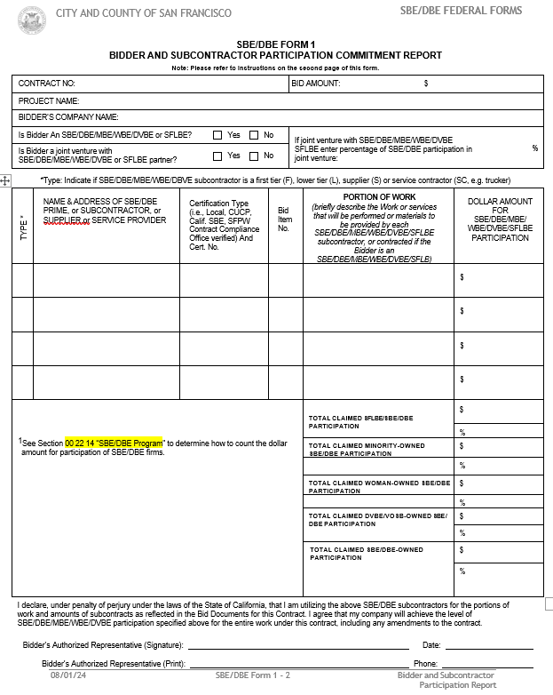
SBE/DBE Form 1
If the SBE/DBE Form 1 is not submitted with the bid or within 5 working Days of the Bid opening, the bid may be deemed non-responsive.
All bidders are required to complete SBE/DBE Form 1 and include the names of the SBEs/DBEs/DVBEs being used, a description of the work the SBEs/DBEs will perform, the services or supplies that will be provided by each SBE/DBE, and the dollar value of each SBE/DBE transaction. (Note: The SBE/DBE subcontractors listed on SBE/DBE Form 1 are also required to be listed on the Proposed Subcontractors Form (Section 00 43 36) when the amount of the subcontractor's bid is in excess of ½ of 1% of the base bid.)

Slide 3
SBE/DBE Form 1 cont’d
Prime Contractors must identify all SBE/DBE/MBE/WBE/DVBE firms participating in the project regardless of tier. Names of the First Tier SBE/DBE/DVBE Subcontractors and their respective item(s) of work listed should be consistent, where applicable, with the names and items of work in the “List of Subcontractors” form submitted.
PLEASE NOTE: It is the bidder’s responsibility to verify that the SBE(s)/DBE(s)/DVBE(s) are certified at the time of bid opening. This verification of the SBE/DBE status, in the form of certification letter or website listing, may be submitted with your bid proposal. If it is not, the apparent low Bidder, and any other Bidder so requested shall submit to the Contract Compliance Officer said verification within five (5) working days after the Bid Opening

Slide 4
SBE/DBE FORM 2 CONTRACTOR/SUBCONTRACTOR PARTICIPATION- GOOD FAITH EFFORTS
This form must be completed and submitted along with compelling documentation detailing the good faith efforts made to meet the SBE/DBE participation goals, if the information submitted on SBE/DBE Form 1 indicates that the SBE/DBE goals have not been met.
If the SBE /DBE participation goals are not met, and if this form, along with compelling documentation detailing the good faith efforts made to meet the goals, is not completed and returned with the bid, the bid may be deemed non-responsive and rejected.
GOOD FAITH EVALUATION
The SFPW Contract Compliance Officer will review the GFE report submitted by the Bidder with its Bid and determine whether, prior to submission of Bid, the Bidder has performed the quality, quantity and intensity of efforts that demonstrates a reasonably active and aggressive attempt to meet the contract-specific goal.

Slide 5
Good Faith Effort Evaluation Process
If the apparent low bidder fails to meet the SBE/MBE/WBE/DVBE Goals, its good faith effort will be evaluated to determine whether it has made adequate good faith efforts. The quality, quantity, and intensity of the different kinds of efforts that the bidder has made will be considered. As part of this evaluation process, the SFPW Compliance Officer will consider the performance of all the other bidders in meeting the goals. For example, when the apparent successful bidder fails to meet the contract goal, but the 2nd, 3rd, 4th and all others meet it, SFPW may reasonably raise the question of whether, with additional reasonable efforts, the apparent successful bidder could have met the goal.
If the apparent low bidder fails to meet at least the average SBE and DVBE commitment of all bidders, its good faith effort may be determined inadequate, and the bid may be declared nonresponsive.
If the apparent successful bidder fails to meet the goal but meets or exceeds the average MBE/WBE/DVBE participation obtained by other bidders, SFPW may view this, in conjunction with other factors, as evidence of the apparent successful bidder having made good faith efforts.

Slide 6
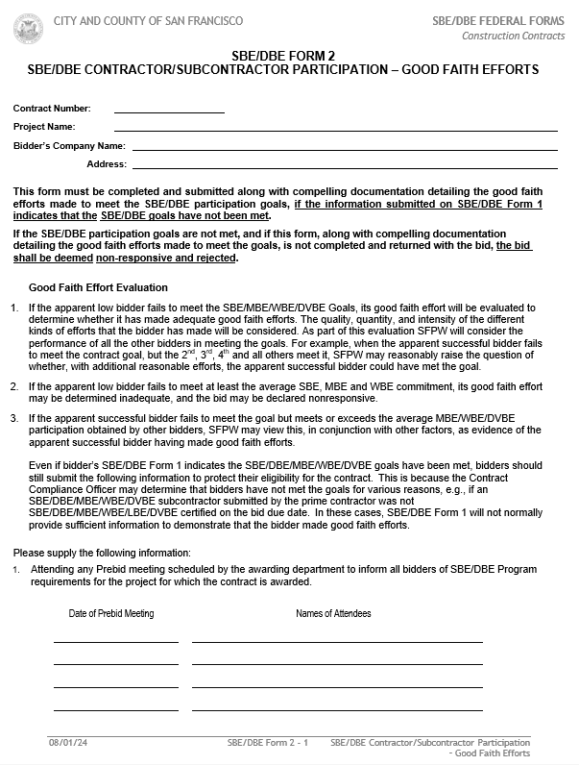
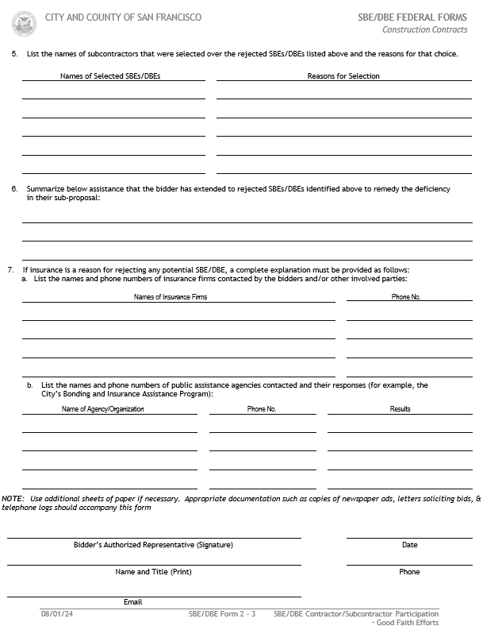
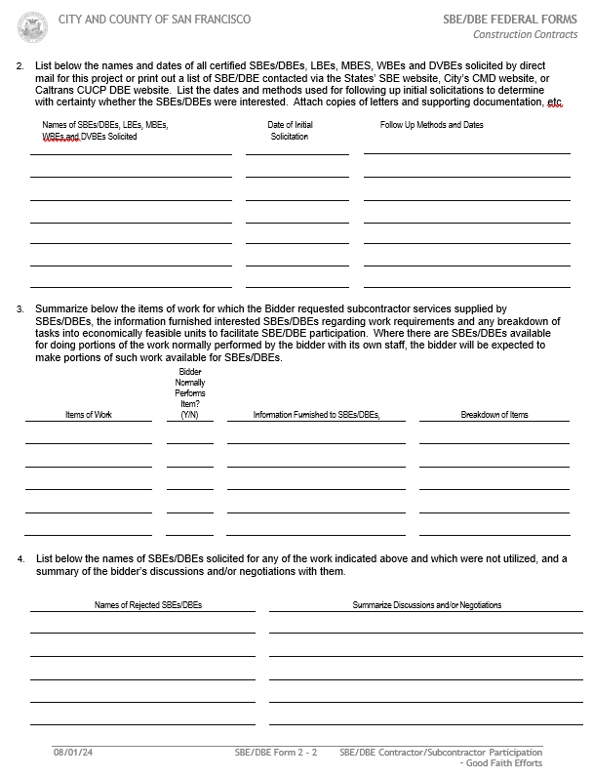
SBE/DBE Form 2
Even if bidder’s SBE/DBE Form 1 indicates the SBE/DBE/MBE/WBE/DVBE goals have been met, bidders are strongly advised to still submit the following information to protect their eligibility for the contract. This is because the Contract Compliance Officer may determine that bidders have not met the goals for various reasons, e.g., if an SBE/DBE/MBE/WBE/DVBE subcontractor submitted by the prime contractor was not SBE/DBE/MBE/WBE/LBE/DVBE certified on the bid due date. In these cases, SBE/DBE Form 1 will not normally provide sufficient information to demonstrate that the bidder made good faith efforts.
A bidder that is not responsive shall be ineligible for award of the contract

Slide 7
Other SBE/DVBE Forms To Be Submitted Within 5 Days of Bid Opening
SBE/DBE Form 2B
SBE/DBE Form 3
SBE/DBE Form 4
SBE/DBE Form 5
SBE/DBE Form 6
SBE/DBE Form 6A (Optional)
GSPD-05-105 State of California- Department of General Services, Procurement Division – Bidder Declaration
DGS PD 843 STATE OF CALIFORNIA DISABLED VETERAN BUSINESS ENTERPRISE DECLARATIONS

Slide 8
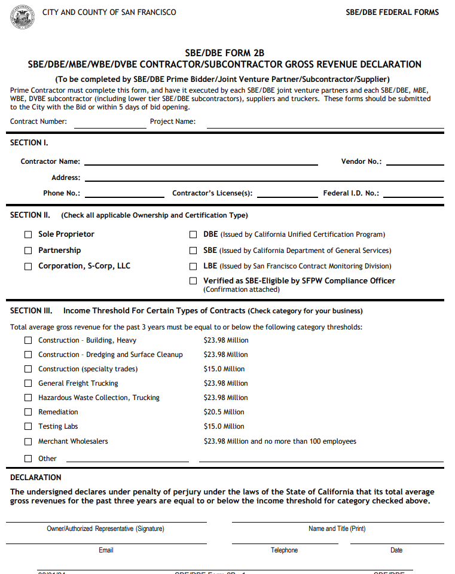
SBE/DBE Form 2B: SBE/DBE/LBE/MBE.WBE.DVBE CONTRACTOR/SUBCONTRACTOR GROSS REVENUE DECLARATION
Prime Contractor must complete this Form, and have it executed by each SBE/DBE joint venture partners and each SBE/DBE, MBE. WBE, DVBE subcontractor (Including lower Tier SBE/DBE subcontractors), suppliers and truckers. These Form should be submitted to the City with the Bid or within 5 Days of bid opening.

Slide 9
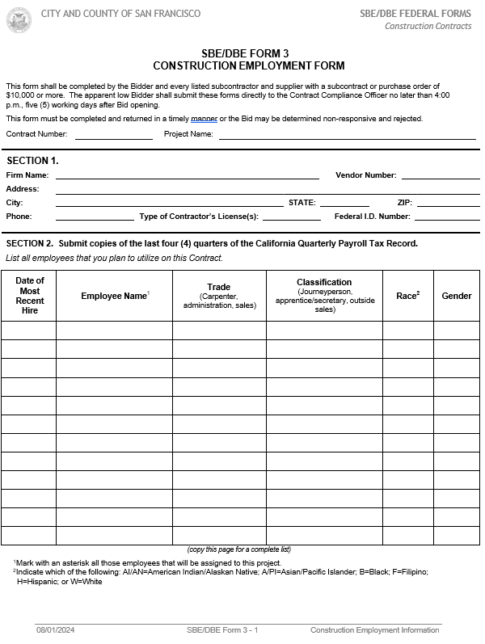
SBE/DBE Form 3: CONSTRUCTION EMPLOYMENT FORM
This form shall be completed by the Bidder and every listed subcontractor and supplier with a subcontract or purchase order of $10,000 or more. The apparent low Bidder shall submit these forms directly to the Contract Compliance Officer no later than 4:00 p.m., five (5) working days after Bid opening

Slide 10
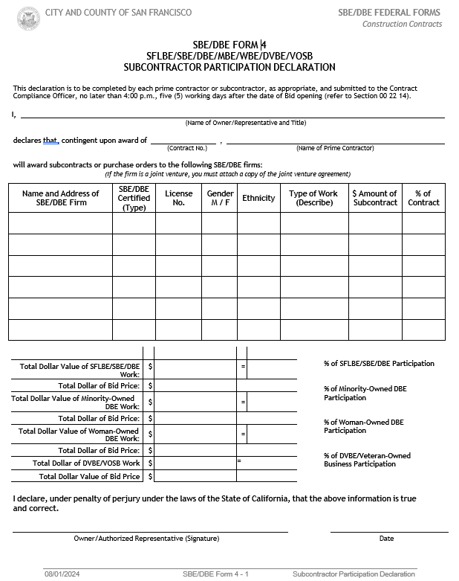
SBE/DBE FORM 4: SFLBE/SBE/DBE/MBE/DVBE/VOSB SUBCONTRACTOR PARTICIPATION DECLARATION
This declaration is to be completed by each prime contractor or subcontractor, as appropriate, and submitted to the Contract Compliance Officer, no later than 4:00 p.m., five (5) working days after the date of Bid opening (refer to Section 00 22 14).

Slide 11
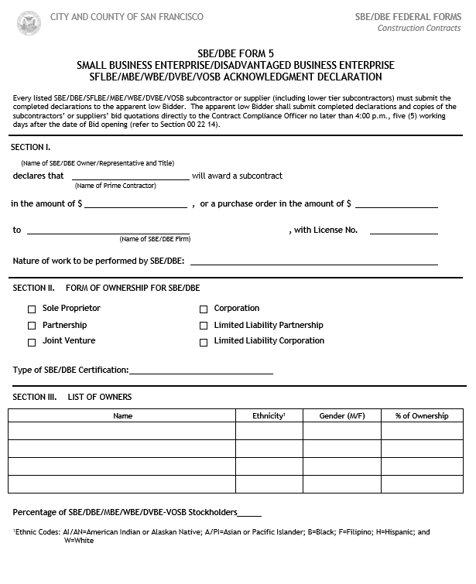
SBE/DBEFORM 5: SMALL BUSINESS ENTERPRISE/DISADVANTAGED BUSINESS ENTERPRISE SFLBE/MBE/WBE/DVBE/VOSB ACKNOWLEDGEMENT DECLARATION
Every listed SBE/DBE/SFLBE/MBE/WBE/DVBE/VOSB subcontractor or supplier (including lower tier subcontractors) must submit the completed declarations to the apparent low Bidder. The apparent low Bidder shall submit completed declarations and copies of the subcontractors’ or suppliers’ bid quotations directly to the Contract Compliance Officer no later than 4:00 p.m., five (5) working days after the date of Bid opening (refer to Section 00 22 14)

Slide 12
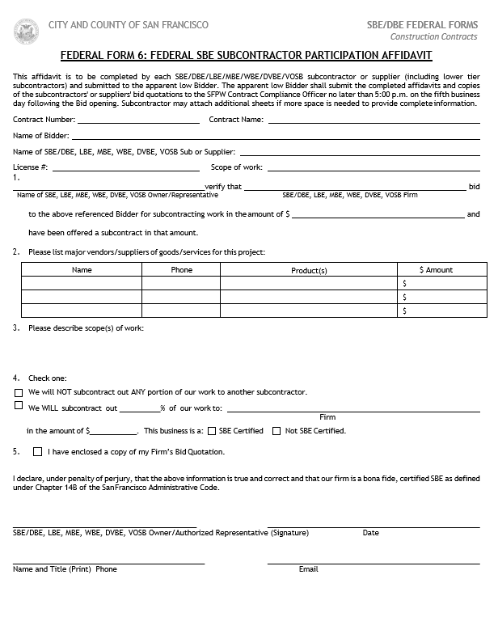
SBE/DBE FEDERAL FORM 6: FEDERAL SBE/DBE SUBCONTRACTOR PARTICIPATION AFFIDAVIT
This affidavit is to be completed by each SBE/DBE/LBE/MBE/WBE/DVBE/VOSB subcontractor or supplier (including lower tier subcontractors) and submitted to the apparent low Bidder. The apparent low Bidder shall submit the completed affidavits and copies of the subcontractors' or suppliers' bid quotations to the SFPW Contract Compliance Officer no later than 4:00 p.m. on the fifth business day following the Bid opening. Subcontractor may attach additional sheets if more space is needed to provide complete information

Slide 13
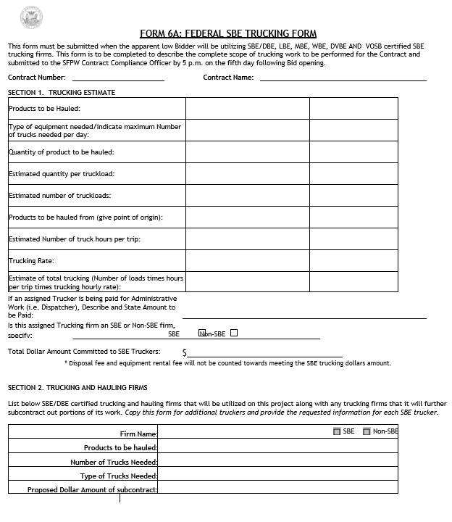
SBE/DBE FEDERAL FORM 6A: FEDERAL SBE TRUCKING FORM
This form must be submitted when the apparent low Bidder will be utilizing SBE/DBE, LBE, MBE, WBE, DVBE AND VOSB certified SBE trucking firms. This form is to be completed to describe the complete scope of trucking work to be performed for the Contract and submitted to the SFPW Contract Compliance Officer by 4:00 p.m. on the fifth day following Bid opening.

Slide 14
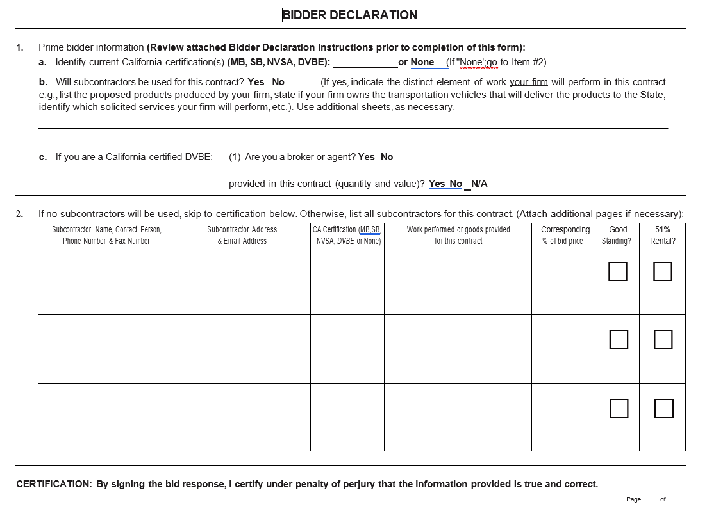
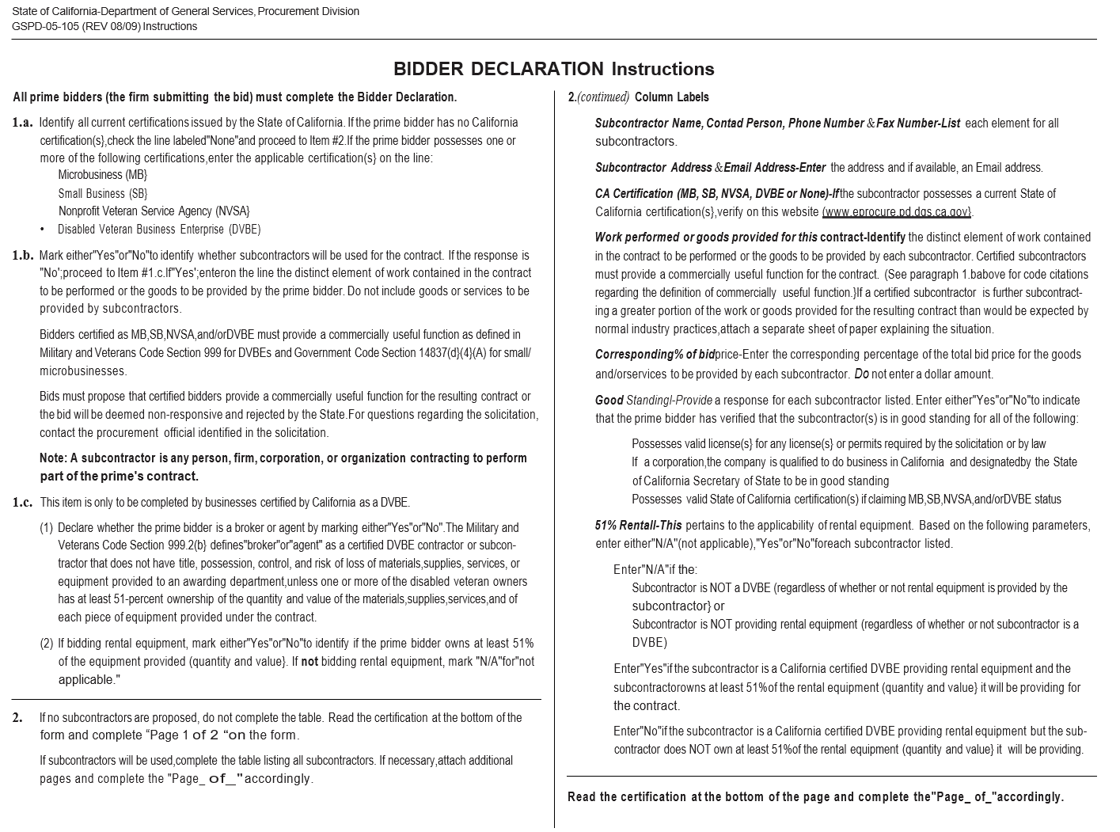
DVBE COMPLIANCE FORMS - GSPD-05-105 State of California- Department of General Services, Procurement Division – Bidder Declaration
Bidder must submit this Form with Bid or Within 5 Days of Bid

Slide 15
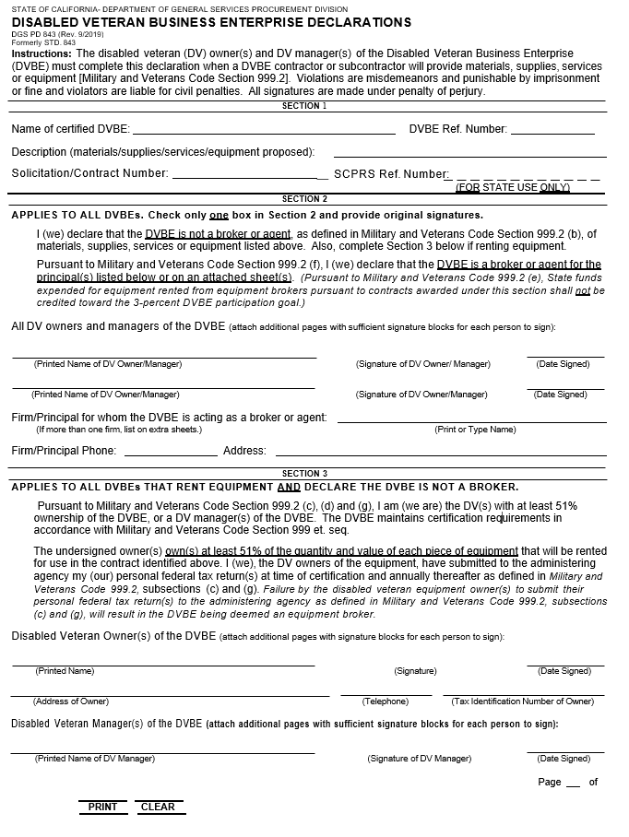
DVBE COMPLIANCE FORMS - DGS PD 843 STATE OF CALIFORNIA DISABLED VETERAN BUSINESS ENTERPRISE DECLARATIONS
The disabled veteran (DV) owner(s) and DV manager(s) of the Disabled Veteran Business Enterprise (DVBE) must complete this declaration when a DVBE contractor or subcontractor will provide materials, supplies, services or equipment [Military and Veterans Code Section 999.2]. Violations are misdemeanors and punishable by imprisonment or fine and violators are liable for civil penalties. All signatures are made under penalty of perjury

Slide 16
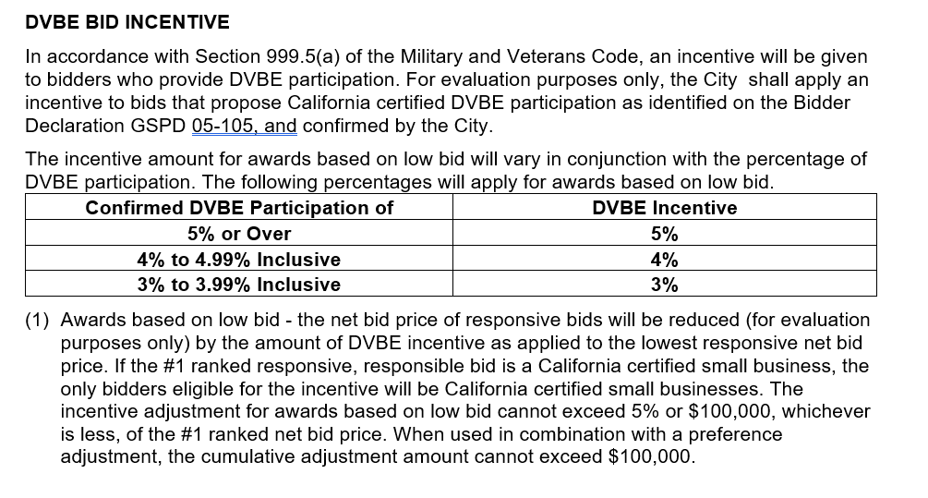
DVBE INCENTIVE

Slide 17
SBE/DBE/DVBE CERTIFICATION LINKS
SBEs must be certified through any of the following programs in order to be counted toward the SBE participation goal:
A. City Program: To get a list of certified San Francisco Small, Micro and Local Business Enterprises, go to: https://sfcitypartner.sfgov.org/pages/LBESearch/supplier-search.aspx
To contact the City’s Contract Monitoring Division and apply for Local Business Enterprise (LBE) certification under the City Program, apply at:
Contract Monitoring Division (CMD)
1455 Market Street, Suite 16A
San Francisco, CA 94103
Attn: Certification Unit
Telephone: (415) 554-0630
B. State Program: To get a list of certified State firms from the California Department of General Services, go to: caleprocure.ca.gov/pages/PublicSearch/supplier-search.aspx
C. California Unified Certification Program (CUCP): To apply for DBE certification under the CUCP, submit a CUCP DBE application. Applications and for a list of DBEs certified by the CUCP, go to: https://caltrans.dbesystem.com/

Slide 18
Questions?
If you have any questions concerning all SBE/DBE and State of California DVBE Form, please contact:
Selormey Dzikunu
SFPW Contract Compliance Manager
Selormey.Dzikunu@sfdpw.org
(628) 271-2094

